Slide 1
Krill size

Slide 2
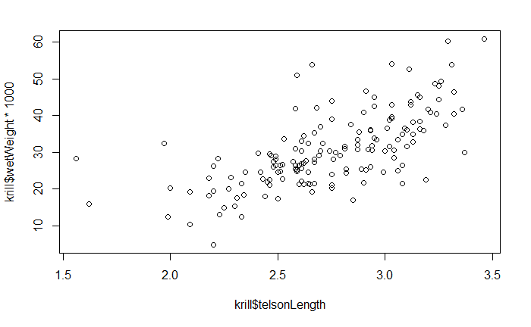
Basic scatter plot of telson length vs. wet weight

Slide 3
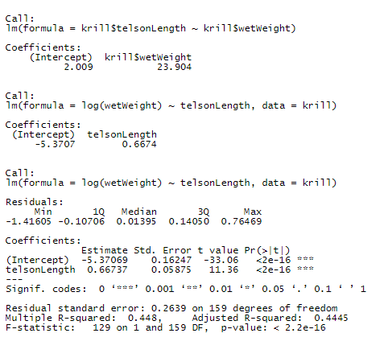
Linear models for length ~ weight + creating body condition

Slide 4
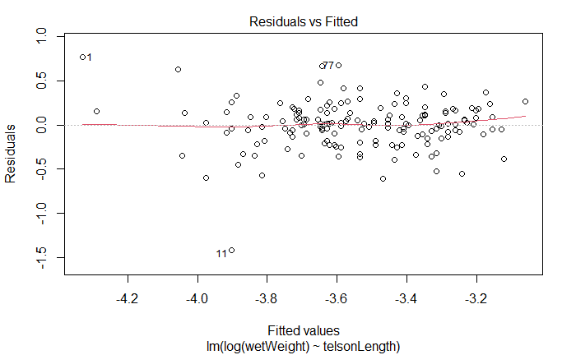
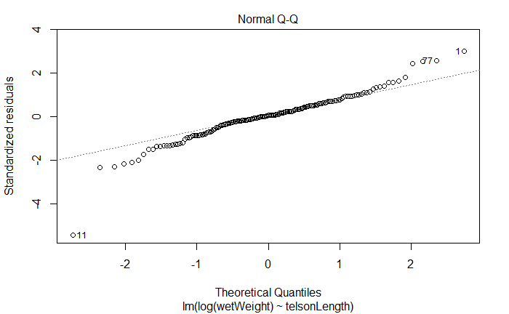
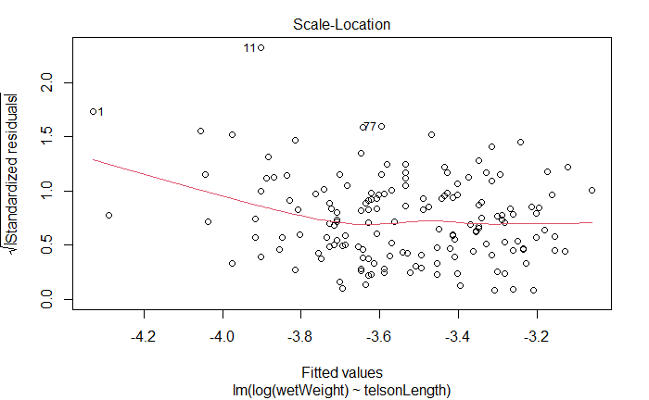
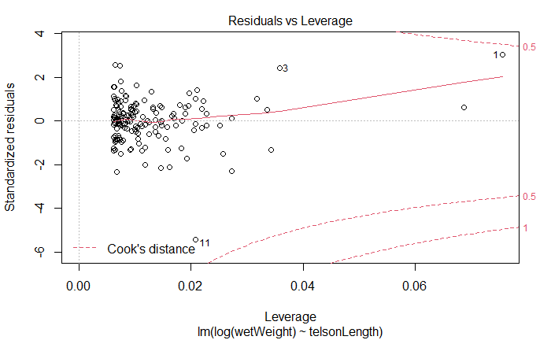

Slide 5
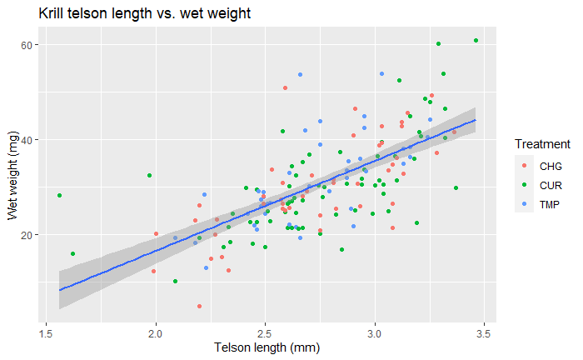
ggplot scatter + treatment

Slide 6
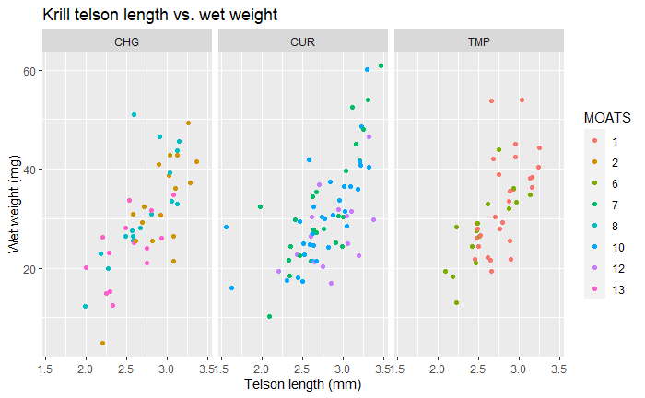
Faceted by treatment

Slide 7
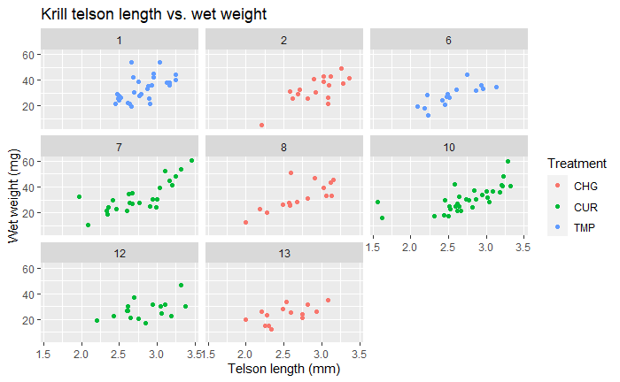
Faceted by MOATS

Slide 8
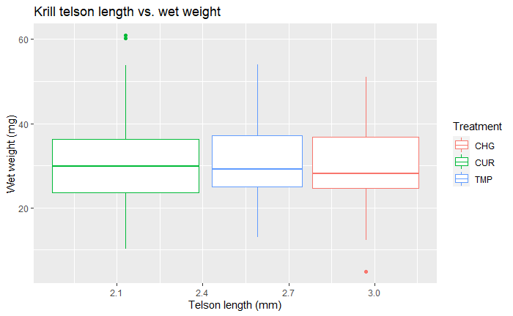
Boxplot by treatment

Slide 9
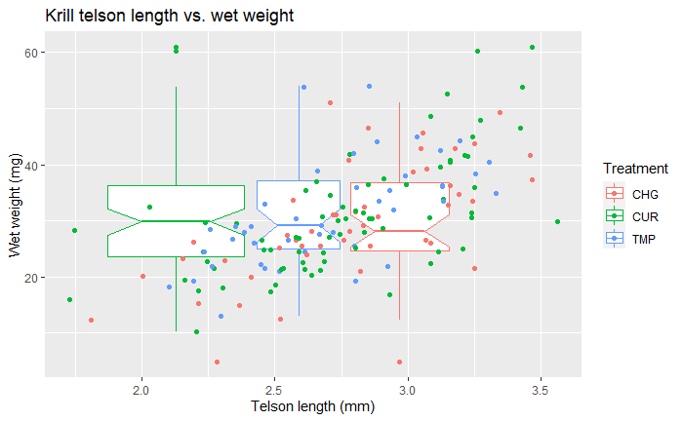
Boxplot by treatment + points

Slide 10
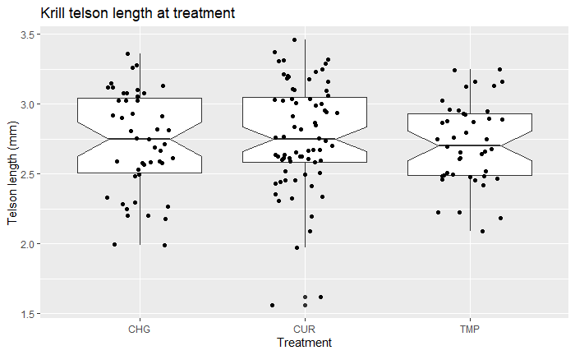
Length at treatment

Slide 11
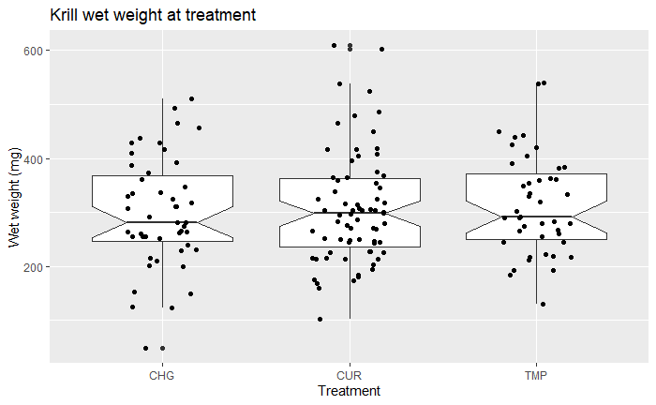
Weight at treatment

Slide 12
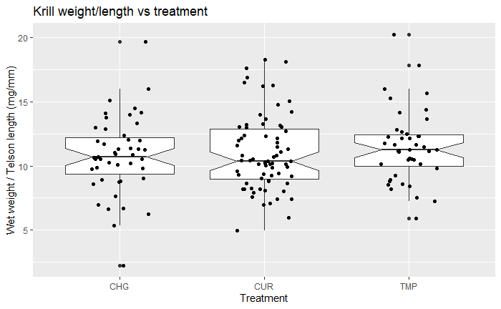
Weight by length at treatment

Slide 13
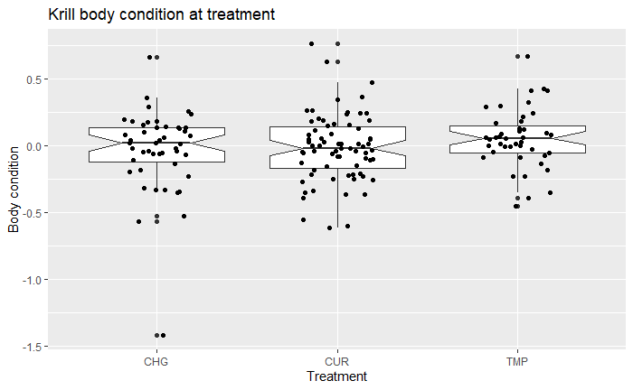
Krill body condition at treatment

Slide 14
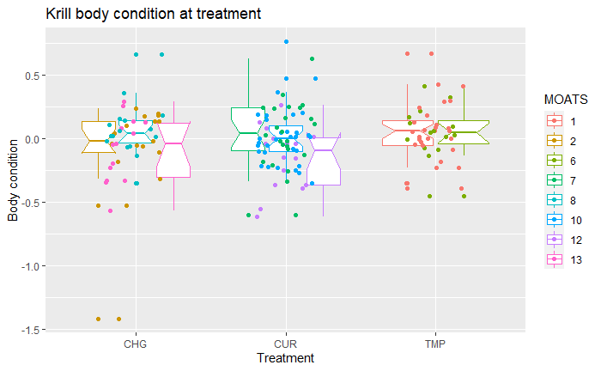
Body condition at treatment by MOATS

Slide 15
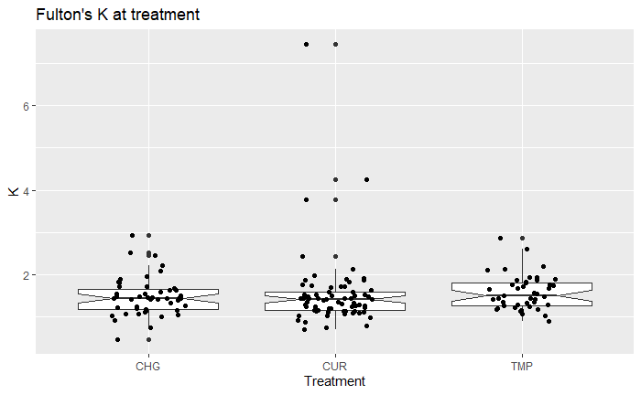
Fulton’s K at treatment

Slide 16
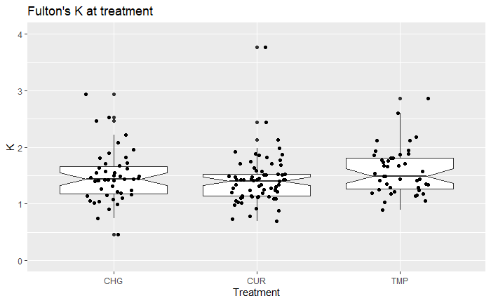
K at treatment, removing larger outliers

Slide 17
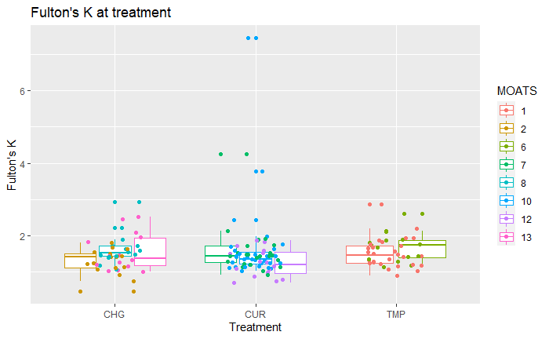
K at treatment, by MOATS

Slide 18
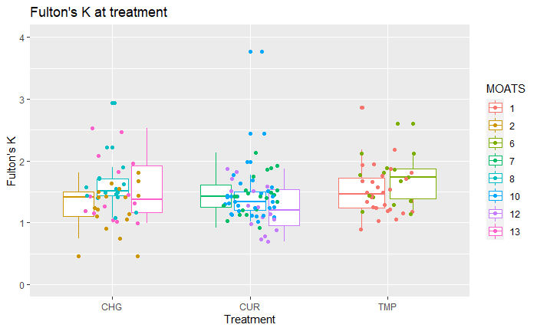
Again, without the outliers

Slide 19
Basic stats

Slide 20
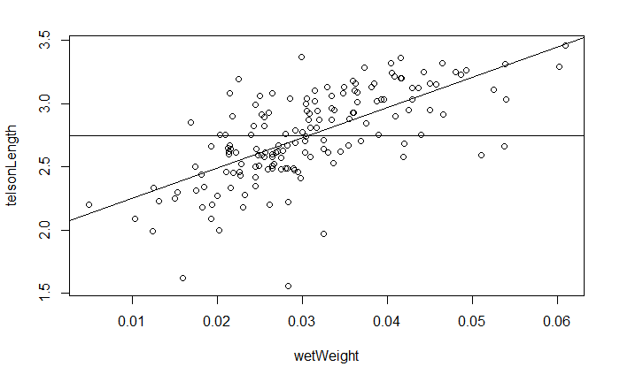
Correlation of telson length and wet weight

Slide 21
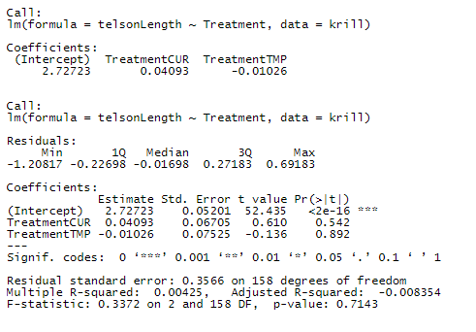
LM of telson length fixed at treatment

Slide 22
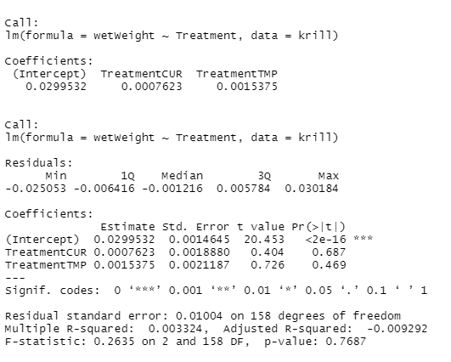
LM of wet weight fixed at treatment

Slide 23
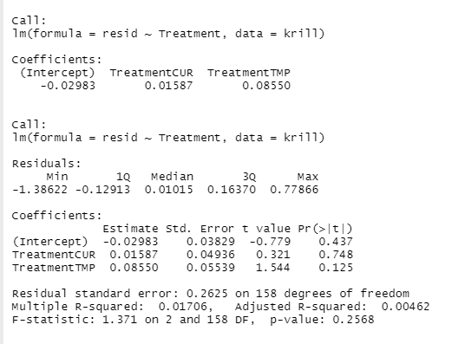
LM of body condition fixed at treatment

Slide 24
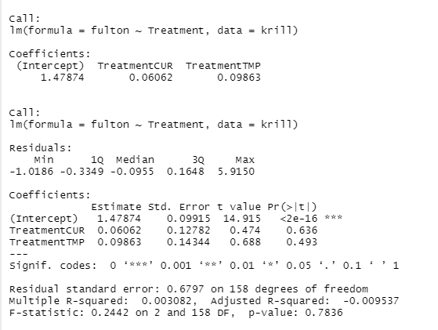
LM of Fulton’s K fixed at treatment

Slide 25
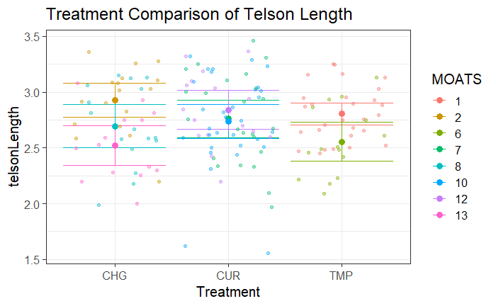
Treatment comparison of TL

Slide 26
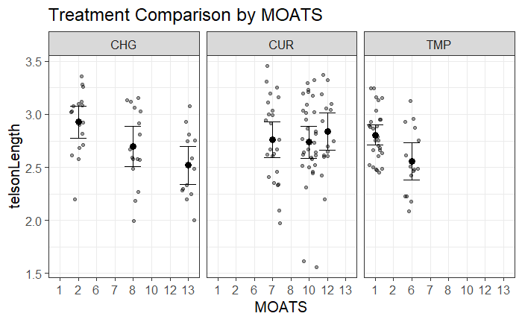
Telson length comparison by MOATS

Slide 27
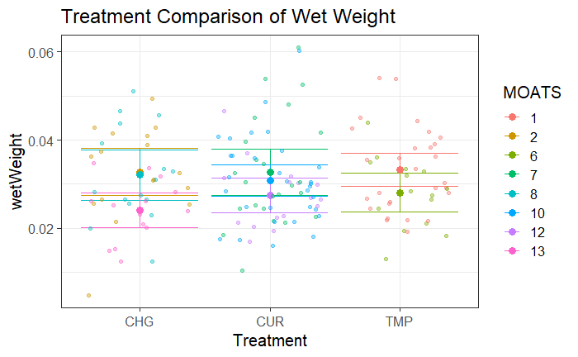
Treatment comparison of weight

Slide 28
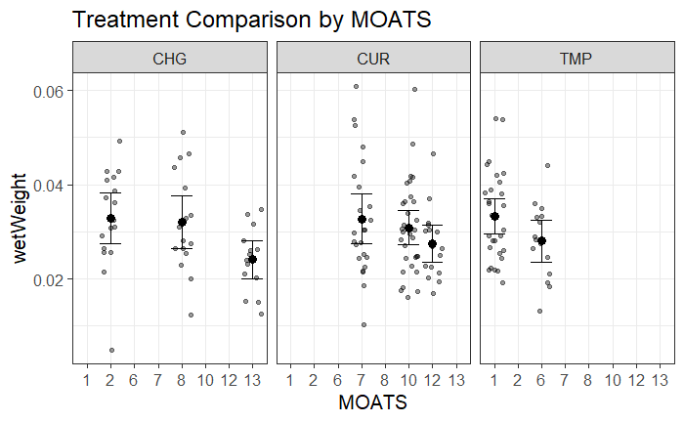
Wet weight comparison by MOATS

Slide 29
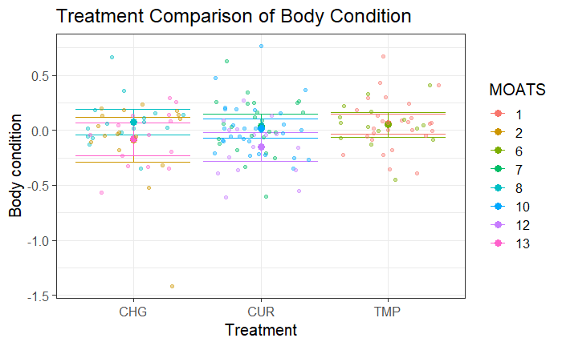
Treatment comparison of body condition

Slide 30
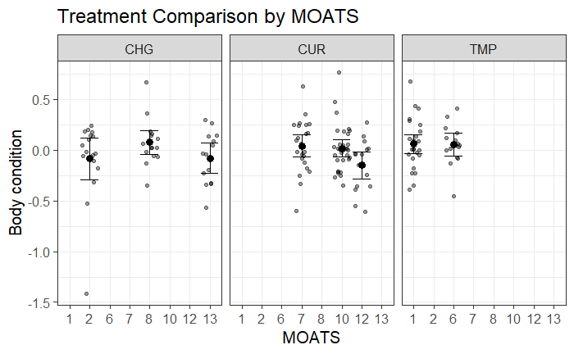
Body condition comparison by MOATS

Slide 31
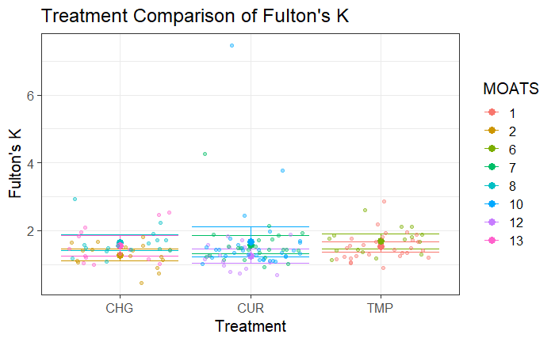
Treatment comparison of Fulton’s K

Slide 32
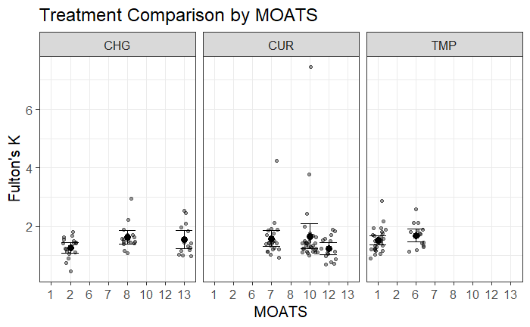
Fulton’s K comparison by MOATS

Slide 33
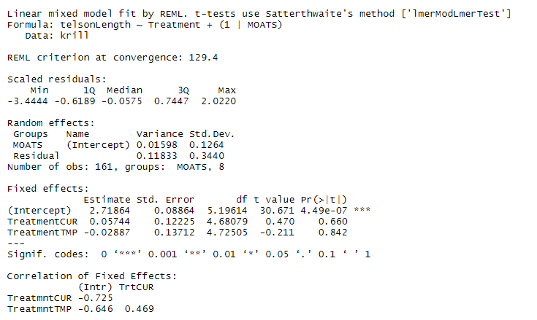
Linear mixed model for telson length

Slide 34
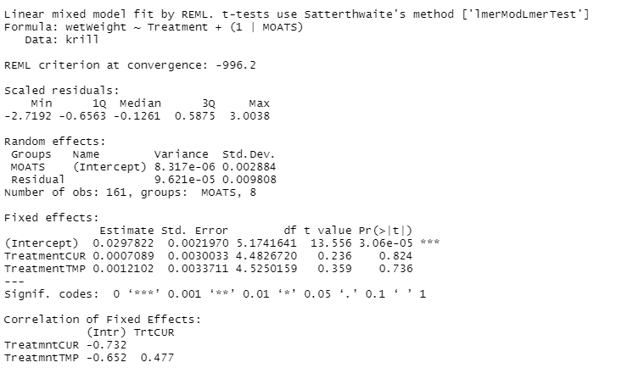
Linear mixed model for wet weight

Slide 35
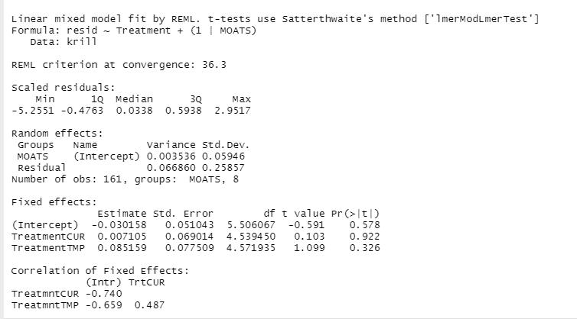
Linear mixed model for body condition

Slide 36
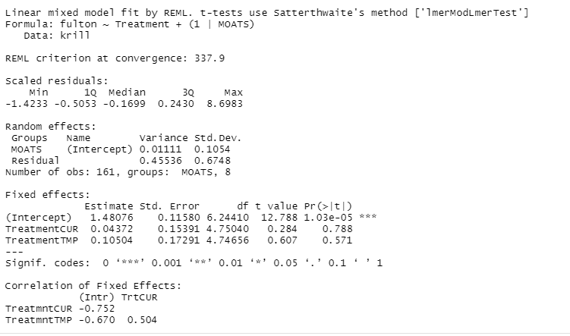
Linear mixed model for Fulton’s K

